Slide 1
Final Presentation
Group #6
High-Bitrate Voice Recorder
By Benjamin Hoang, Angelica Olmedo, Jeremy Magana, Jarrett Koran

Slide 2
App Description
High bitrate voice recorder with many other features to compliment the app.
Ability to record and save audio from the phone emulation.
Login feature with FireBase when the app is opened so user has to log in to access.
Small permissions that ask the user to access the microphone
Notifications for when recording finishes
BottomNavigation using fragments.

Slide 3
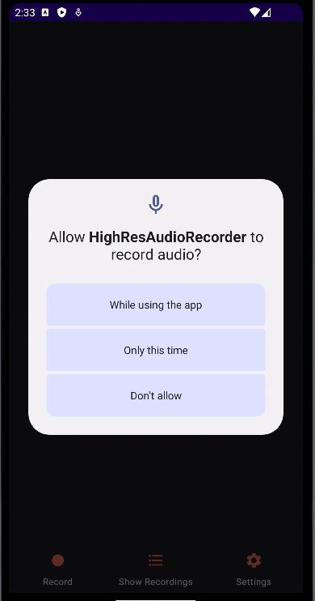
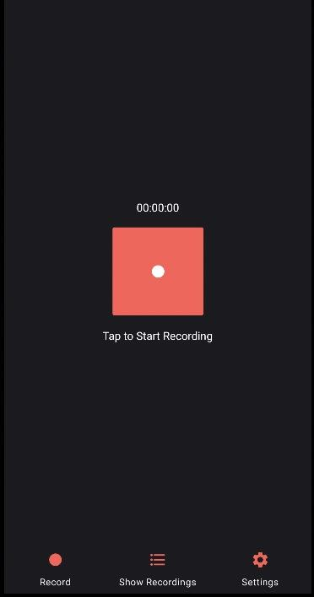
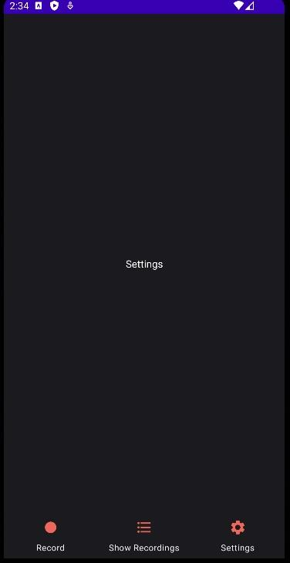
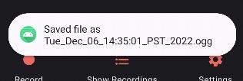

Slide 4
Challenges, and Innovation
Trying to fit in 10 different concepts proved to be challenging because we had to come up with different ways for the concepts to fit within the app.
Innovated the LiveData and login feature so that we can add more concepts.
Challenge with balancing the software engineering process alongside with other projects from other courses.
Still have to implement a few features of the app

Slide 5
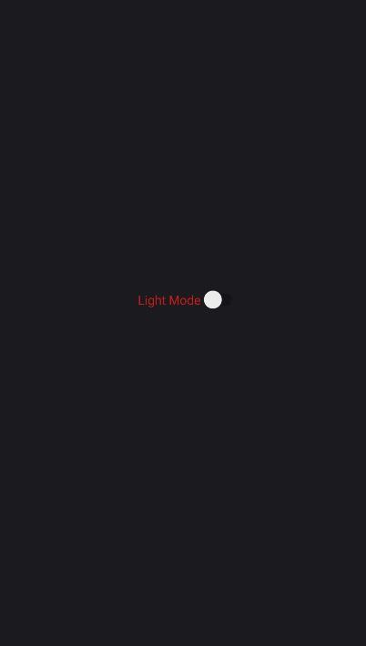
Limitations, what we want to implement by December 15th.
Finish up with our settings fragment so that user may have a choice between formats such as light mode and dark mode.
Have more unit tests.
Room database to store audio data
LiveData number when recording
MVVM design pattern

Slide 6
Implementation of android concepts
Login page: contains Firebase
Recording: contains Live Data, notifications, and permissions
The notification in the previous slides tells the user the audio was saved with the filename using a toast message.
List of recording: contains RecyclerView and Room
Main Activity: contains Navigation between Fragments
In addition we are using MVVM and unit test cases to make sure everything is performing as it should.

Slide 7

Room Database
Room DB will be used to store audio recordings
Room uses SQLite
Makes handling CRUD very easy

Slide 8
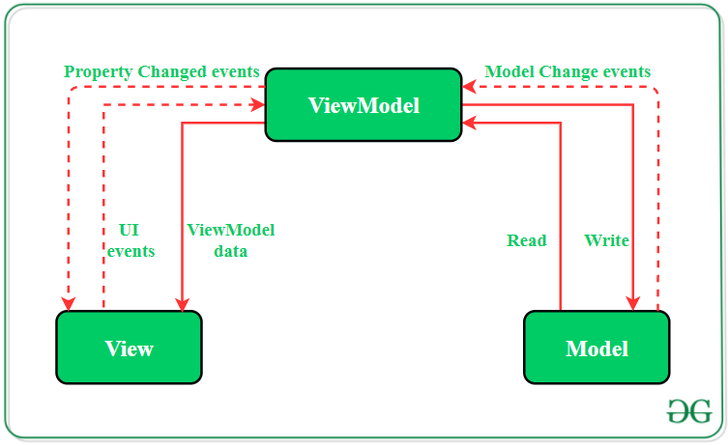
MVVM Design Pattern
We will be using an MVVM design pattern
ViewModel handles the front end inputs and interactions
Model handles backend calculations and events
ViewModel and Model are handled in separate packages and communicate with each other

Slide 9

Uploading to Google Play
Our application will be uploaded to the Google Play Store
We plan to use Google Play Console to upload the application
One time charge of $25 to create a Google Developer account
Once this account has been created, the owner can publish unlimited apps to the Google Play Store

Slide 10
Conclusion
Ultimately, we are not quite there yet with what we want to be implemented but we are quite close to implementing all of the android concepts and are confident in meeting the deadline of December 15th.

Slide 11

Demo

